Slide 1
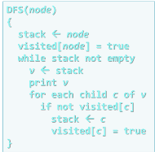
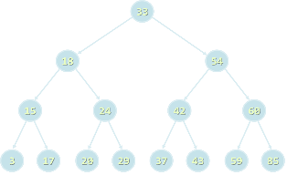

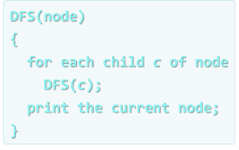


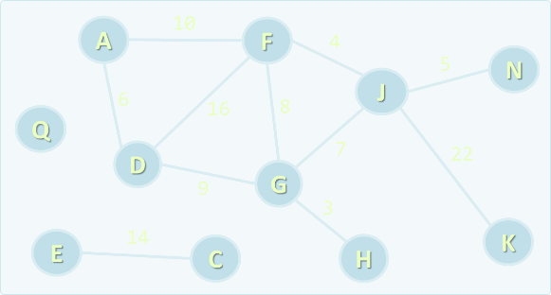
Data Structures
Course Overview
Data
Structures
SoftUni Team
Technical Trainers
Software University
http://softuni.bg

Slide 2

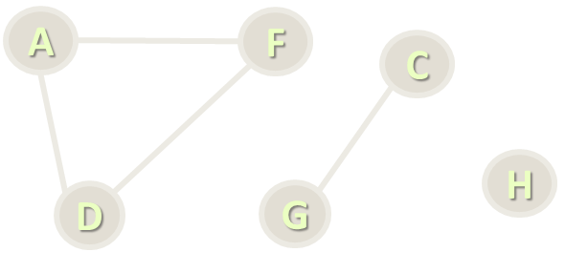
Table of Contents
Course Program
Trainers Team
Examination
Learning Resources

Slide 3
Have a Question?
sli.do #DsAlgo

Slide 4

Data Structures
Course Program

Slide 5
Data Structures – Course Program
Course Overview
Linear Data Structures – Lists and Complexity
Linear Data Structures – Stacks and Queues
Basic Tree Data Structures
Tree Traversal Algorithms – BFS and DFS
Heaps and Priority Queues
B-Trees and Red-Black Trees

Slide 6
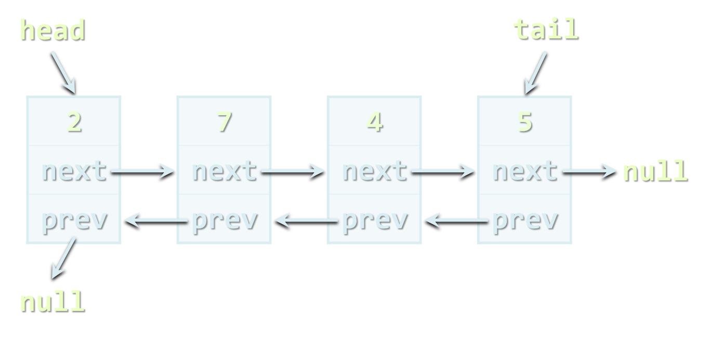
Data Structures – Course Program (2)
AA-Trees and AVL trees
Rope and Trie
Quad Trees, K-d Trees, Interval Trees
Hash Tables, Sets and Dictionaries
Combining Data Structures
Exam Preparations x 2
Practical Exam

Slide 7
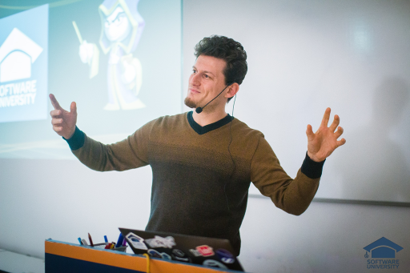
The Trainers Team

Slide 8

Trainers Team
Georgi Angelov
Technical Trainer @ Software University
Top performing student from the Software University
Majoring in Computer Science at University of Telecommunications and Posts, Sofia
Passionate when it comes to programming

Slide 9

Training Duration – Data Structures
Lessons: ~ 25 hours (onsite + YouTube videos)
Practical exercises (in class labs): ~ 25 hours
Exam preparation: 8 hours
Homework: ~ 30-50 hours
Schedule: January – March 2018
Practical exam: 11 March 2018

Slide 10
Programming Languages
The recommended language for this course is C#
Exercises in class assume you will write in C# + Visual Studio
Labs and examples will also focus on C# and Visual Studio
Homework can be submitted in C# or Java
At the final exam attendees can use:
C# or Java

Slide 11


Scoring System for the "Data Structures"
Practical exam
90%
Labs/Homework
(1 week deadline after exercise)
up to 10% bonus
Contribution in the forum:
up to 10% bonus

Slide 12


Data Structures – Practical Exam
2 problems for 6 hours
Data structure + Command execution system
E.g. hierarchy + add + get parent, etc.
E.g. add + edit + remove tickets + search, etc.
Available unit tests to test solution
Automated judge system / real-time feedback

Slide 13









Resources
What We Need Additionally?

Slide 14



Data Structures Web Site, Forum and FB Group
Official web site:
Official discussion forum:
Official Facebook groups:
https://softuni.bg/trainings/1857/data-structures-january-2018
https://softuni.bg/forum/categories/32/strukturi-ot-danni-i-algoritmi
https://www.facebook.com/groups/527825767610618/

Slide 15



Data Structures Slides and Videos
All lecture slides, videos, homework assignments, labs and other resources are open content, available for free
Visit the course web site to access the course resources

Slide 16


Data Structures – Additional Resources
Nakov P., Dobrikov P., "Programming = ++ Algorithms;", 5th Edition, ISBN: 954-8905-06-X, Faber Publishing (2015)
Download a free copy from: www.programirane.org
No English version (Bulgarian only)
Cormen T., Leiserson C., Rivest R., Stein C., "Introduction to Algorithms", 3rd Edition, ISBN 978-0262033848, MIT Press (2009)
Find the book in Internet: https://goo.gl/ElgQD3

Slide 17
Recommended Software
Visual Studio Community 2017
Or other C# development environment
SharpDevelop – lightweight IDE for C#
Xamarin Studio – powerful IDE for C# / .NET for Linux, Mac OS X, Windows and others
Wintellect Power Collections
https://powercollections.codeplex.com
Eclipse / IntelliJ IDEA (for Java), Code::Blocks (for C++)

Slide 18







Data Structures Course Introduction
https://softuni.bg/opencourses/data-structures

Slide 19
License
This course (slides, examples, labs, videos, homework, etc.) is licensed under the "Creative Commons Attribution-NonCommercial-ShareAlike 4.0 International" license
Attribution: this work may contain portions from
"Fundamentals of Computer Programming with C#" book by Svetlin Nakov & Co. under CC-BY-SA license
"Data Structures and Algorithms" course by Telerik Academy under CC-BY-NC-SA license

Slide 20






Free Trainings @ Software University
Software University Foundation – softuni.org
Software University – High-Quality Education, Profession and Job for Software Developers
softuni.bg
Software University @ Facebook
facebook.com/SoftwareUniversity
Software University @ YouTube
youtube.com/SoftwareUniversity
Software University Forums – forum.softuni.bg

